Slide 1

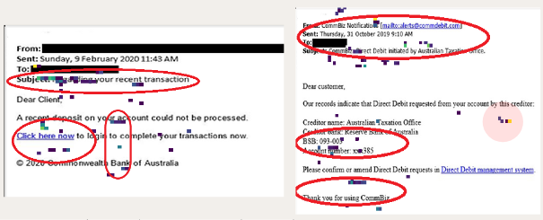
Characterisation of Human Behaviours Against Cyber Attacks
Chanon Kachornvuthidej 44456553, Supervisor: Dr. Dan Kim
Background Information
Phishing: impersonating a trustworthy entity to gain sensitive information
70% of cyber attacks employ a form of phishing techniques
Email phishing are commonly used with a phishing site which accounts for 96% of all phishing
Spear, whaling, and pharming are common techniques employed
There are many advanced anti-phishing tools but phishing rate is growing exponentially, 65% growth in 2019 compared to past years
Why does anti-phishing software fails?
Users are ignoring the warnings
Security indicators are ineffective
Overlooked the nature of human psychology
Very little efforts are made to investigate the human factors and thought processes of online users when encountering phishing scams
Current research design
Aim : Develop a generic framework to conduct human centric cybersecurity research with a demonstrated example of an email phishing study design. The exemplar study will investigate what visual components of email does user use to gauge whether it is a genuine or phishing email, and how improvements can be made.
Participants: 12 participants were included all are students of Bachelors and Masters level in various study discipline
Apparatus: 40 sample emails (20 real and 20 phishing) were used to represent common emails received from well-known companies and government oragnisations. Gaming Grade Tobii 4C eye tracker model were used to capture eye gaze.
Methods: Participants will view series of emails and have to classify them as phishing or genuine while their gaze are captured with an eye-tracker. This is followed by answering a short survey about the task and demographics.
Result: Users spent on average 26 seconds reading each email with 70% correct response rate. Government email samples have the highest incorrect response rate. Social media has 100% correct response rate. Area of interest includes the email subject line, sender address, corporate logo, hyperlinks and buttons.
The framework
Stimuli design
Research and selection of the apparatus
Data gathering and analysis
Discussion and improvement suggestions
Implications and Limitations
Finance was the key limitation
The framework can help structure future human centric cybersecurity research projects
Helps understand basic cognitive process of users when performing online activites
Data could be used to improve the UX/UI design of the automated-phishing tools for better protection

